Slide 1
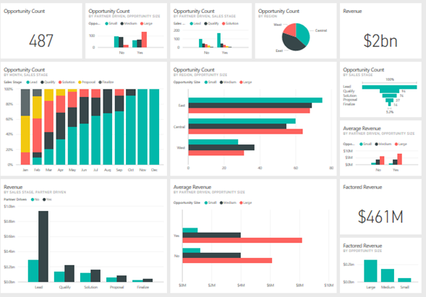
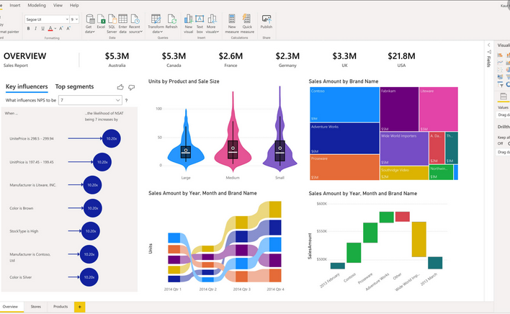
BI & Dashboards

Slide 2
Business Intelligence
Definition of Business Intelligence
[Broad Definition] An umbrella term that combines architectures, tools, databases, analytical tools, applications, and methodologies.
[Narrow Definition] Descriptive analytics tools and techniques (i.e., reporting tools).
A Brief History of B I – 1970s → 1980s → 1990s …
The Origins and Drivers of B I (See Figure 1).
The Architecture of B I (See Figure 2).

Slide 3
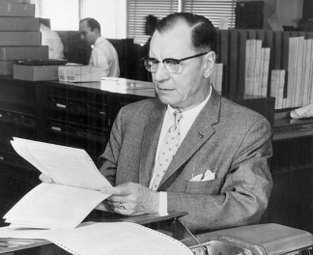
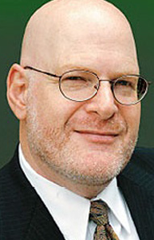
Brief History of BI
1960-70s
1980-90s
In 1958, IBM Researcher Hans Peter Luhn publishes "A Business Intelligence System." Hans is later named the Father of Business Intelligence.
Later in 1970’s the first few BI vendors pop up with tools that are meant to help in accessing and organizing data.
During 1988, The Multiway Data Analysis consortium, an International conference to streamline data processes, held in Rome.
In 1989, Howard Dresner defines business intelligence as we know it today: "Concepts and methods to improve business decision making by using fact-based support systems."
In 1989, the use of the term "business intelligence" becomes widespread.
Notes:
https://www.klipfolio.com/resources/articles/brief-history-of-business-intelligence

Slide 4
Brief History of BI
In 2005, with social media platforms like Facebook and Twitter on the rise, the amount of data created started skyrocketing.
In 2008, business intelligence, analytics and performance management revenue reached $8.8 Billion.
In 2010, 35% of organizations employ pervasive BI. 67% of "best in class" companies have some self-service BI.
Notes:
https://www.klipfolio.com/resources/articles/brief-history-of-business-intelligence

Slide 5
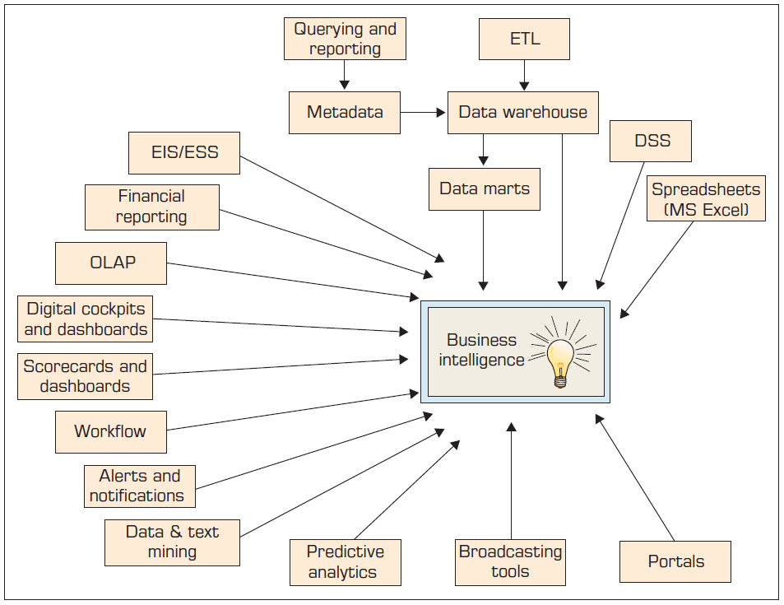
Evolution of Business Intelligence (B I)
Figure 1
© 2011 Pearson Education, Inc. publishing as Prentice Hall
Notes:
An Executive information system (EIS), also known as an Executive support system (ESS), is a type of management support system that facilitates and supports senior executive information and decision-making needs. It provides easy access to internal and external information relevant to organizational goals.

Slide 6
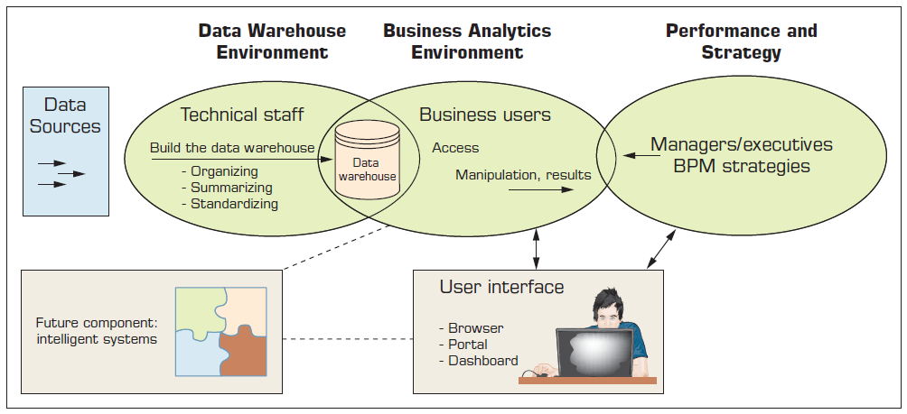
A High-Level Architecture of B I
Figure 2

Slide 7
Business Reporting Definitions and Concepts
Report = Information → Decision.
Report?
Any communication artifact prepared to convey specific information.
A report can fulfill many functions.
To ensure proper departmental functioning.
To provide information.
To provide the results of an analysis.
To persuade others to act.
To create an organizational memory…

Slide 8
What is a Business Report?
A written document that contains information regarding business matters.
Purpose: to improve managerial decisions.
Source: data from inside and outside the organization (via the use of E T L (extract, transform, load)).
Format: text + tables + graphs/charts.
Distribution: in-print, email, intranet.
Data acquisition → Information generation → Decision making → Process management

Slide 9
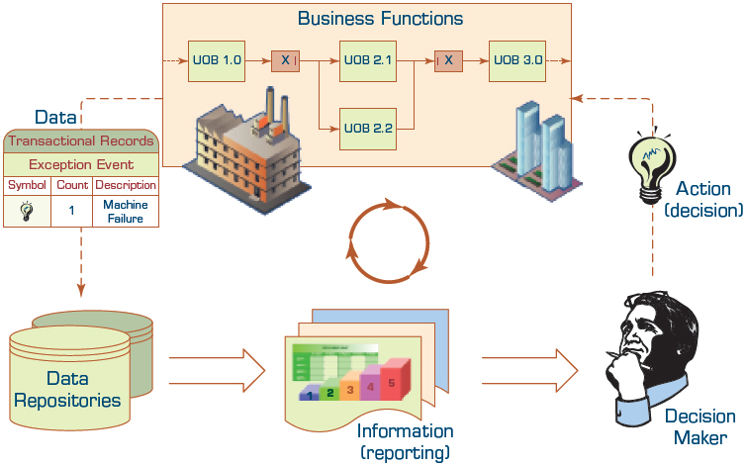
Business Reporting

Slide 10
Types of Business Reports
Metric Management Reports.
Help manage business performance through metrics.
Can be used as part of Six Sigma.
Dashboard-Type Reports.
Graphical presentation of several performance indicators in a single page.
Balanced Scorecard–Type Reports.
Include financial, customer, business process, and learning & growth indicators.

Slide 11
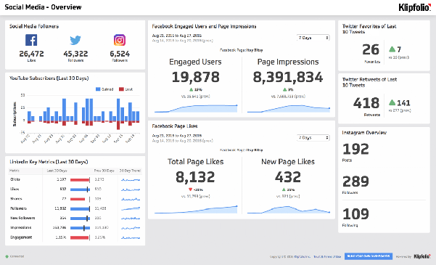
Dashboards

Slide 12
Best Practices in Dashboard Design
Wrap the Metrics with Contextual Metadata.
Validate the Design by a Usability Specialist.
Prioritize and Rank Alerts and Exceptions.
Enrich Dashboard with Business-User Comments.
Provide for Guided Analytics.
etc.

Slide 13
Types of Dashboards
Three common types of dashboards - strategic, tactical, and operational.
Strategic dashboards are being commonly used whilst aligning company's strategic goals.
Tactical dashboards seem to be the best for measuring a progression of most important projects.
Operational dashboards provide the most precise abilities, so that they're being commonly used for monitoring and analyzing company's activities in a given business area.

Slide 14
Strategic dashboards
Useful for the highest level of company management, the strategic aspect of a company considers stating, determining and achieving goals within an enterprise.
Enable a dive down to lower levels of company's hierarchy.
Strategic dashboards provide exceptionally-wide functionalities

Slide 15
Tactical dashboards
Tactical dashboards, unlike strategic, are prepared for more detailed purposes, usually being used for tracing the trends in relation to company's goals and initiatives.
Managers get a possibility to control how market reacts on company's actions.
Managers might investigate how each particular task influences on company as a whole.
In most cases, preset goals are being measured.
Thereupon, it's not so important to measure the goal itself, but to check how different the planned value is from the actual execution.

Slide 16
Operational dashboards
While strategic and tactical dashboards are designed for executives, operational dashboards are being used mostly on operational level (in a given department, by its employees).
Operational dashboards provide detailed insights, while general reviews aren't a part of their users' interest.
Operational dashboards are being used on departmental level, they have to be prepared for enabling detailed analysis and particular processes.

Slide 17
Advantages of dashboards
Total Visibility into Your Business.
Big Time Savings.
Improved Results.
Reduced Stress.
Increased Productivity.
Increased Profits.

Slide 18
The Funnel
Describes your customer’s journey with you.
From the initial stages when someone learns about your business, to the purchasing stage, marketing funnels map routes to conversion and beyond.
Lot of debates around the topic “Funnel”.
Marketing or Sales?
Is this still relevant to today’s consumer buying process?

Slide 19
The Funnel continue …
A marketing funnel lets you know what your company must do to influence consumers at certain stages.
By evaluating your funnels, you can potentially drive greater sales, more loyalty and stronger brand awareness.
There is not a single agreed upon version of the funnel.
Ideally, marketing funnel would actually be a marketing cylinder.

Slide 20
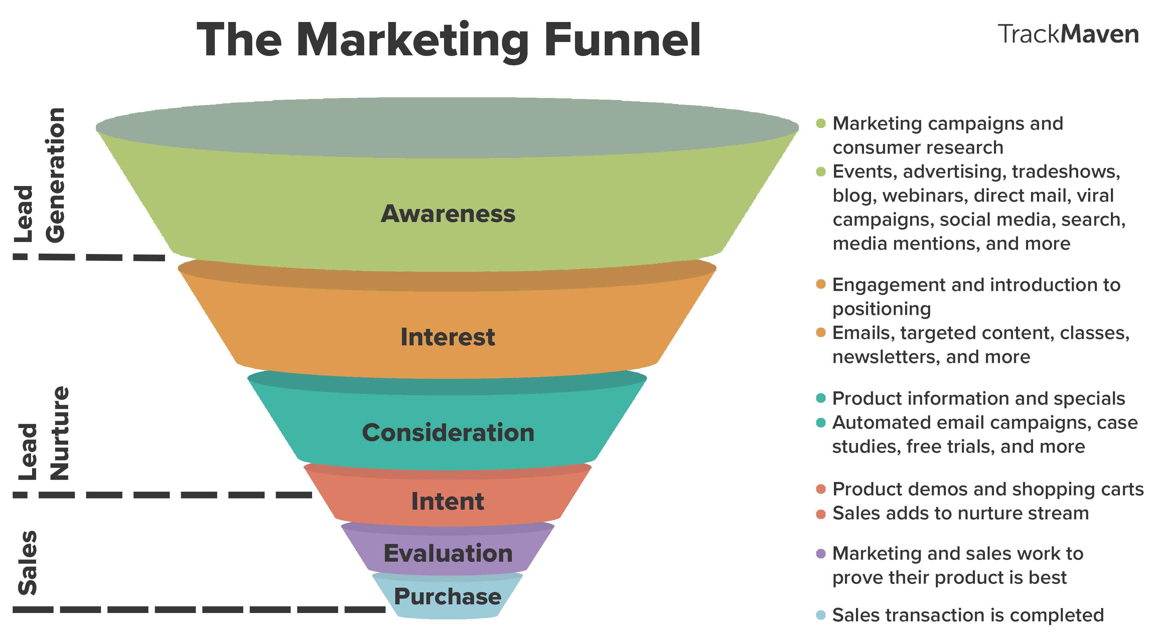
The Funnel continue …
Notes:
Viral Campaigns ?

Slide 21
The Funnel (Awareness)
Awareness is the uppermost stage of the marketing funnel.
Potential customers are drawn into this stage through marketing campaigns and consumer research and discovery.
Trust and thought leadership is established with events, advertising, trade shows, social media , and more.
Here, lead generation takes place, as information is collected and leads are pulled into a lead management system for nurturing further down the funnel.

Slide 22
The Funnel (Interest)
Once leads are generated, they move on to the interest stage, where they learn more about the company, its products, and any helpful information and research it provides.
Here is an opportunity for brands to develop a relationship with the people in its lead database and introduce its positioning.
Marketers can nurture leads through emails, content that is more targeted around industries and brands, classes, newsletters, and more.

Slide 23
The Funnel (Consideration)
In the consideration stage, leads have been changed into marketing qualified leads and are seen as prospective customers.
Marketers can send prospects more information about products and offers through automated email campaigns, while continuing to nurture them with targeted content, case studies, free trials, and more.

Slide 24
The Funnel (Intent)
To get to the intent stage, prospects must demonstrate that they are interested in buying a brand’s product.
This can happen in a survey, after a product demo, or when a product is placed in the shopping cart on an ecommerce website.
This is an opportunity for marketers to make a strong case for why their product is the best choice for a buyer.

Slide 25
The Funnel (Evaluation)
In the evaluation stage, buyers are making a final decision about whether or not to buy a brand’s product or services.
Typically, marketing and sales work together closely to nurture the decision-making process and convince the buyer that their brand’s product is the best choice.

Slide 26
The Funnel (Purchase)
This is the last stage in the marketing funnel, where a prospect has made the decision to buy and turns into a customer.
This is where sales takes care of the purchase transaction.
A positive experience on the part of the buyer can lead to referrals that fuel the top of the marketing funnel, and the process begins again.

Slide 27
Credits
Vivek Kale, Enhancing Enterprise Intelligence: Leveraging ERP, CRM, SCM, PLM, BPM, and BI (CRC Press).
Dr Manaz Kaleel PHD
Mr Sean Heeney
Pearson Education, Inc. publishing as Prentice Hall

